Slide 1

Radiology Information System
Zachary Mace,
Kevin Freyre,
Andrew Davis,
Cole Ledford

Slide 2
Team Responsibilities
Zachary Mace – Team Lead
Features Architecture
Front/Back End development
Web Hosting
Debugging
Stress Testing
Kevin Freyre – Scribe
Front/Back End development
Debugging
Stress Testing
Documentation
Andrew Davis
User Info feature owner
Modeling and Design
Stress Testing
Debugging
Cole Ledford
Billing feature owner
Modeling and Design
Stress testing
Debugging

Slide 3
RIS Workflow
RIS Purpose: manage information and workflow in a radiology department
Schedule and register patients
Process patients and upload images
Create, format and diagnostic reports
Track film folders
Maintain billing information
Generate management & performance reports
Consort Institute Accelerated Training in Health Information Technology

Slide 4
Project Description
Install one of the two supplied RIS systems
Test system and identify defects
Modify system to address the bugs discovered
Add two additional features to the system through software engineering process
Requirements
Design
Implementation
Verification
Maintenance

Slide 5
New Project Features
Billing
User Info
Cost of appointment is assigned and determined by modality
Addition of Insurance information and price in appointment scheduling.
Billing statement sent to patient after having checked-in for their appointment
Ability for users to manually edit their account information such as password, email and display name

Slide 6
Project Tools Used
Development Environment
VisualStudio Code
Java Extension Pack
Git for VSCode
MySQL 8.0
Server
Workbench
JDK 14.0.2
Apache-Maven 3.6.3
Source Control
Github
Web Development Framework
SpringBoot 2.4.4
Spring Security 5.4.6
Spring Email 2.3.4
Hibernate JPA
Diagram Tools
Diagrams.net
DBDiagram.io
MySQL Workbench
Communication and Coordination
Discord
Microsoft Teams
Jira

Slide 7
Project Agenda
Planning 06/30/2021 – 07/07/2021
Analyzed team member experience
Outlined project requirements
Familiarized with project tools
System Install/Testing 07/07/2021 – 07/14/2021
Installed system to maintain
Setup database
Began testing and identifying issues
Debugging
Feature Implementation 07/14/2021 – 07/21/2021
Researched potential new features
Feature approvals
Began designing/developing new features
Feature Testing 07/21/2021 – 07/28/2021
Finished developing features
Tested and identified issues
debugging
Project Finalization 07/28/2021 – 08/01/2021
Finished all deliverables and gathered all documentation

Slide 8
Lessons Learned

Slide 9
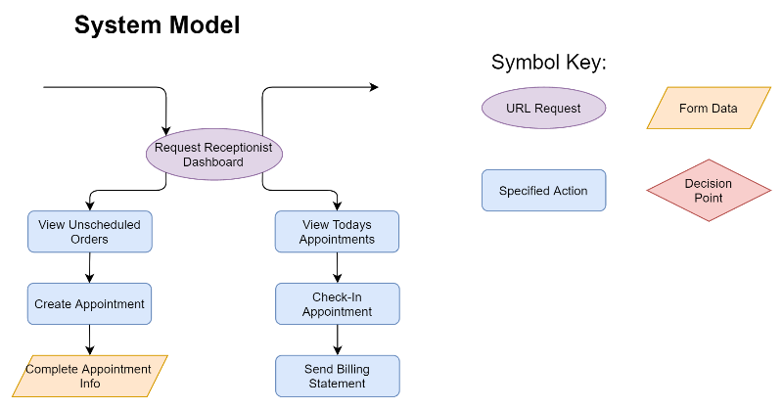
Billing Feature
Functional Requirements
Ability to change the price based on the choosing of a modality.
Retrieval of Insurance information at the time of appointment scheduling.
Total cost of modality displayed on receptionist dashboard as well as at the time of appointment scheduling
Delivery of an email with price of modality as well as insurance information provided
Nonfunctional Requirements
Reliably provide modality price and insurance info through email.
Maintain Data integrity by safeguarding personal information from unauthorized/uncredentialled personnel
Provide serviceability and maintainability to future email features

Slide 10
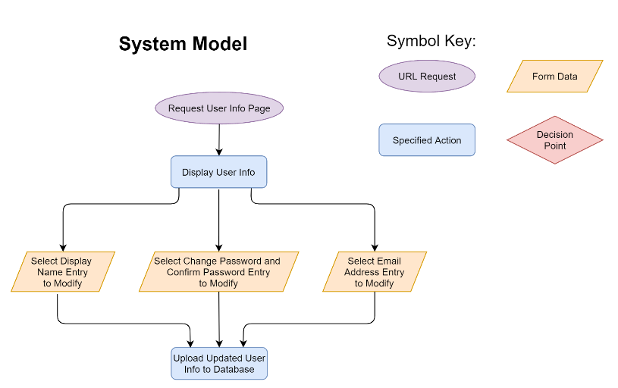
User Info Feature
Functional Requirements
Allow user to update password, display name and email address
Allow user to view user id and username
Prevent user from updating user id and username
Nonfunctional Requirements
Provide adaptability by allowing end users to change user info
Provide accessibility by allowing user to view information that pertains to them
Providing usability in an easy to use, simple dashboard for users

